Slide 1
CodeCrusaders
Interledger Student Hackathon 2025

Slide 2
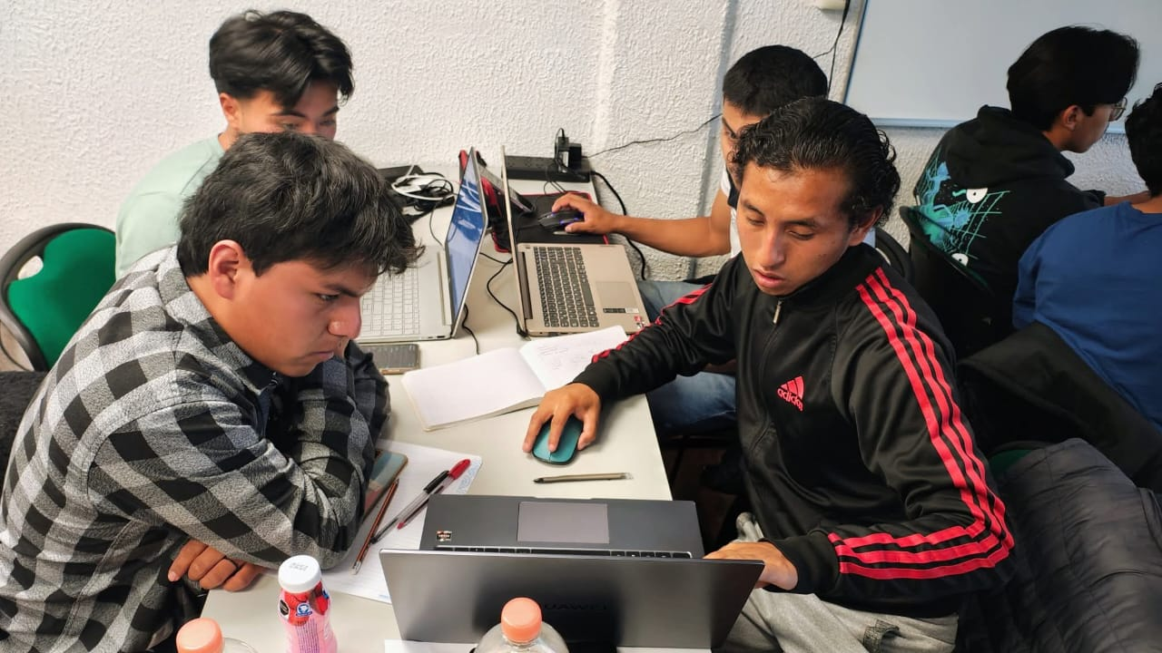
Meet the CodeCrusaders
Diego Deciderio García: Backend and blockchain expert, the mind behind our architecture.
Daniel Hernández Martínez: Business strategist, focusing on viability and impact.
Eric Hernández Ramírez: UX/UI designer, ensuring that our solution is intuitive and user-friendly.
Emanuel Domingo Bernal: Full-stack developer, the bridge between front and back.

Slide 3
A real problem: The financial gap in rural communities
Exclusion: Millions of people without access to basic banking services.
Costs: High fees and long journeys to carry out transactions.
Inefficiency: Lack of interoperability between systems, creating “islands” of money.
Gap: Difficulties in digitization and local economic growth.

Slide 4
Our solution
AIC is a digital financial hub that uses the Interledger Protocol (ILP) to connect communities with the financial ecosystem.
It enables secure and efficient cash-in, cash-out, and P2P transactions directly within the community.

Slide 5
Why is our solution the winner?
For the Community: Promotes inclusion and retention of local capital.
For Users: Simple, secure transactions available 24/7.
For Business: A scalable and validated model, ready for growth.

Slide 6
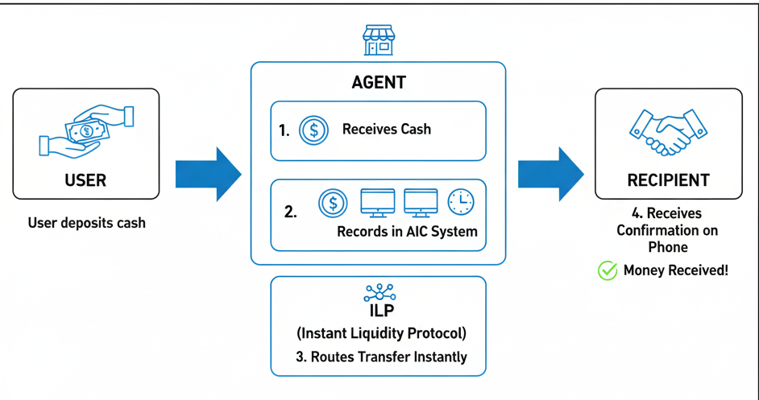
The magic behind the AIC

Slide 7




Technologies used

Slide 8
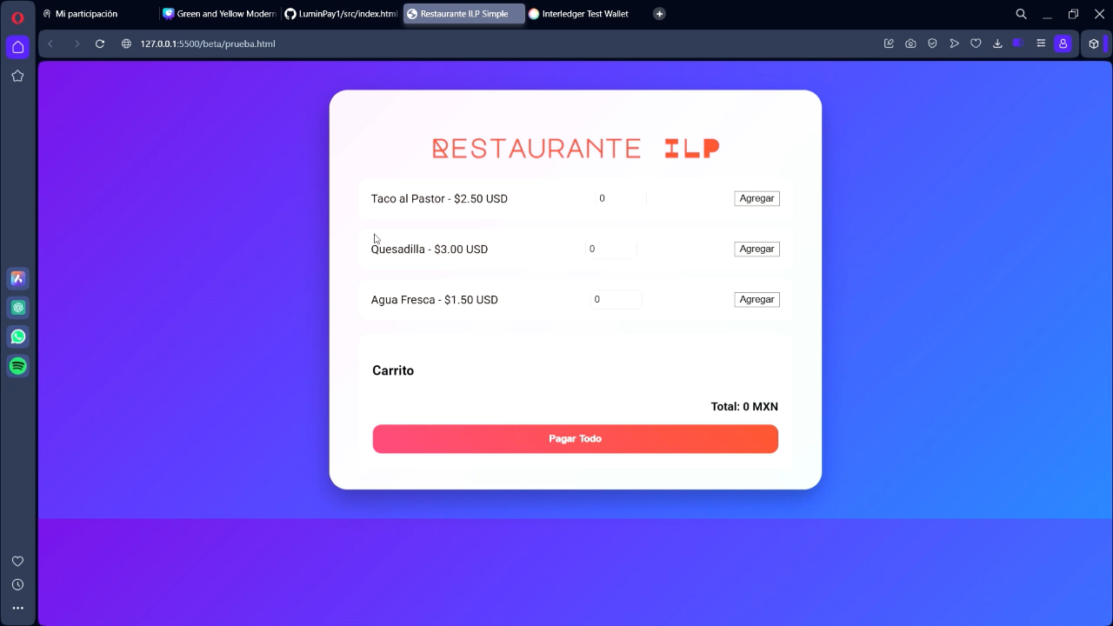
Let's get to work!

Slide 9
Beyond the hackathon: Our future
Expansion: Bring AIC to more pilot communities.
Partnerships: Seek strategic partners (cooperatives, NGOs) to scale up the project.
Evolution: Add new features such as microloans or financial education.

